Slide 1

WELCOME

Slide 2

INTRODUCE
Teacher
Md. Azahar Ali
Ass. Teacherh
Palashihata M.L. High school and College
Fulbaria, Mymensingh.
Mobile:01917853124

Slide 3
Topic
Class –Nine
Unit- Three Lesson-03
Title-International Mother Language Day-1

Slide 4
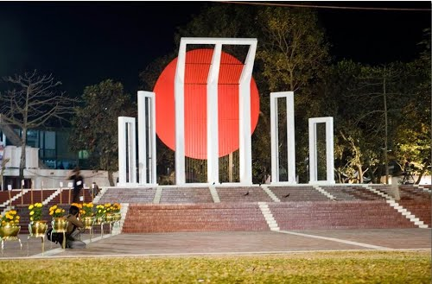
Part-A
Look at the pictures and try to realize what they mean.

Slide 5
See the following video

Slide 6
TODAY’S LESSON
International Mother Language Day- 01

Slide 7
LEARNING OUT COMES
After this lesson you will be able to-
Talk about event .
Match the word.
Answer the questions.

Slide 8

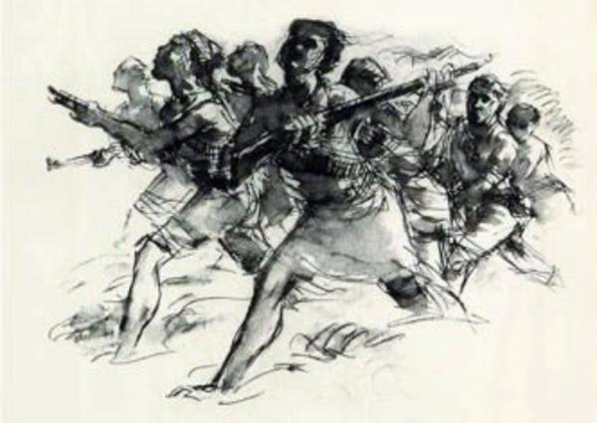
New Words
Memorable - Realize, remember. Martyr - Die for one’s country.

Slide 9
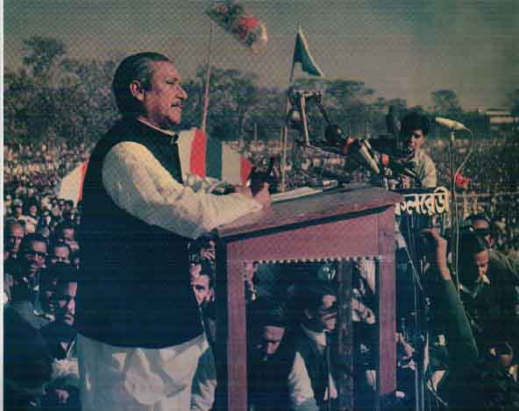
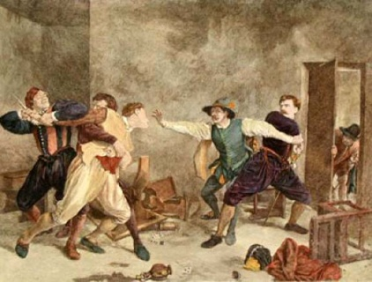
Similar Words
Declaration –
Announcement.
Movement -
War, fight

Slide 10

Similar Words
Independent-
Free.

Slide 11
Tropic Presentation
Reading text(Loud Reading)

Slide 12
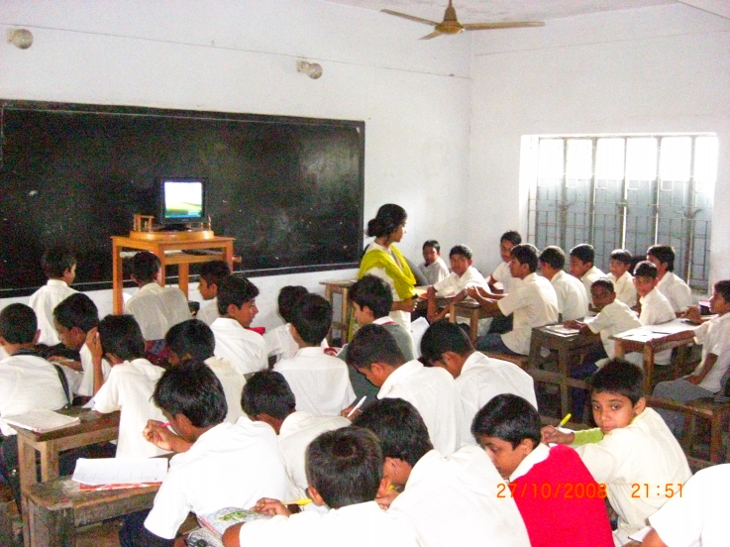
PART-C (INDIVIDUAL WORK)
Time | What happened
1947
1948
1952

Slide 13
Answer (Part-C)
Time | What happened
1947 | Divided India and Pakistan.
1948 | The seed of language movement sown.
1952 | The language movement held.

Slide 14
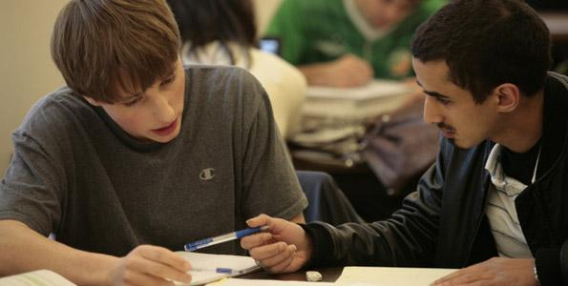
PART-D (PAIR WORK)
Match the words with their meaning

Slide 15
CHECK THE ANSWER-D
Words | Meanings
Tribute | An act to show respect or admiration.
Climax | The most exciting point in time
Outlaw | To ban.
Defy | To refuse to obey.
Provoke | To have a particular effect.
Relent | To give in.
Momentum | The ability to keep increasing or developing.

Slide 16
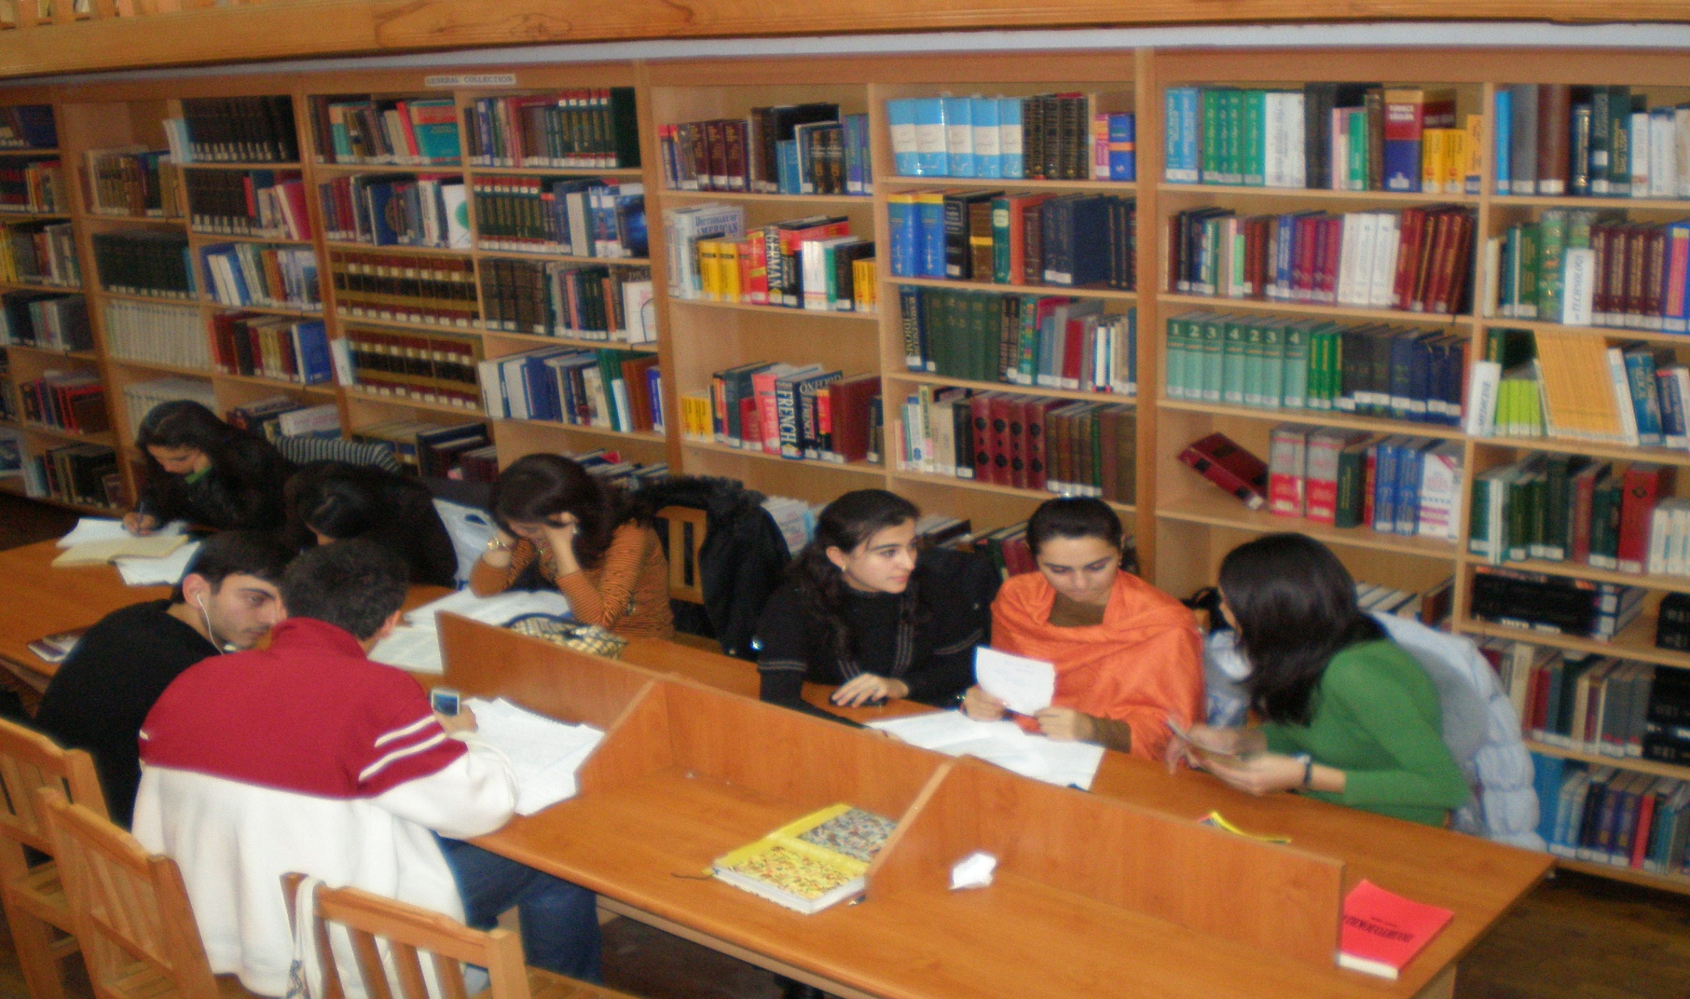
PART-E(GROUP WORK)
Answer these questions from the text.

Slide 17
EVALUATION
What is International Mother Language Day ?
When was the seed of language movement sown?
What was the significant of language movement ?

Slide 18
PART-F (HOME WORK)
Write briefly how you observed this year’s 21 February at your school.

Slide 19

THANK YOU

